Slide 1
Ciência de Dados Quântica 2022/23 Kernel Based Methods and Feature Maps
Luís Paulo santos

Slide 2
Material de Consulta
[Schuld2021] – Secs. 2.5.4, 3.6.1; Chap. 6
“Support Vector Machines: All you need to know!” https://youtu.be/ny1iZ5A8ilA
“The Kernel Trick in Support Vector Machine (SVM)” https://youtu.be/Q7vT0--5VII
Qiskit Global Summer School 2021: Lectures 6.1 https://www.youtube.com/watch?v=xgA4Dx_7q34&list=PLOFEBzvs-VvqJwybFxkTiDzhf5E11p8BI
Andrew Ng, Course Notes CS229: chapters 5 and 6 https://cs229.stanford.edu/main_notes.pdf

Slide 3
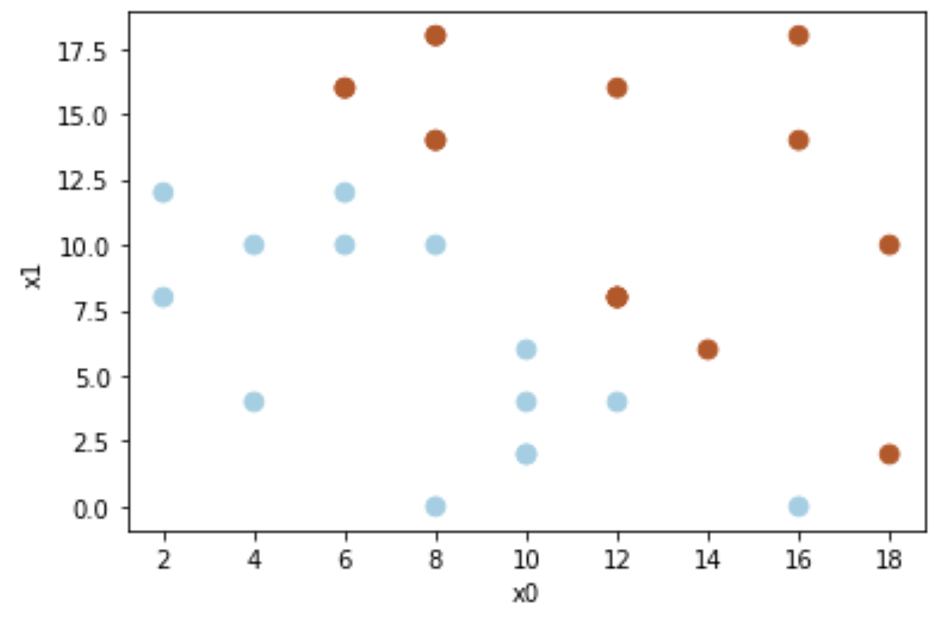


Recalling Linear Classifiers
Binary classification
Let each d-dimensional data point be:
$x={\left\{x_{1},⋯,x_{d}\right\}}^{T}$
${x′=\left\{1,x_{1},⋯,x_{d}\right\}}^{T}$
Let the linear model be:
$f_{θ}\left(x\right)=θ_{0}+θ_{1}x_{1}+⋯+θ_{d}x_{d}=θ^{T}x^{′}=\left\langle θ,x′\right\rangle$
$y_{θ}\left(x\right)=2∗step\left(θ^{T}x′\right)−1=\left\{\begin{matrix}−1← ∙ <0 \\ +1← ∙ ≥0\end{matrix}\right.$
$$𝒪\left(d\right)$$
$$y_{θ}\left(x\right)=2∗step\left(θ_{0}+θ_{1}x_{1}+θ_{2}x_{2}\right)−1$$

Slide 4


Recalling Linear Classifiers
We have seen that to learn a linear classifier using Least Minimum Squares as the cost function and stochastic gradient descent, for a randomly selected data point $\left(x^{(i)},y^{(i)}\right)∈𝔇$, we have at each iteration $t$:
$$θ_{k}^{(t+1)}=θ_{k}^{(t)}+η\left(y^{(i)}−{θ^{\left(t\right)}}^{T}{x′}^{\left(i\right)}\right){x′}^{\left(i\right)}$$
$$\left\langle θ^{\left(t\right)},{x′}^{\left(i\right)}\right\rangle \sim 𝒪\left(d\right)$$

Slide 5
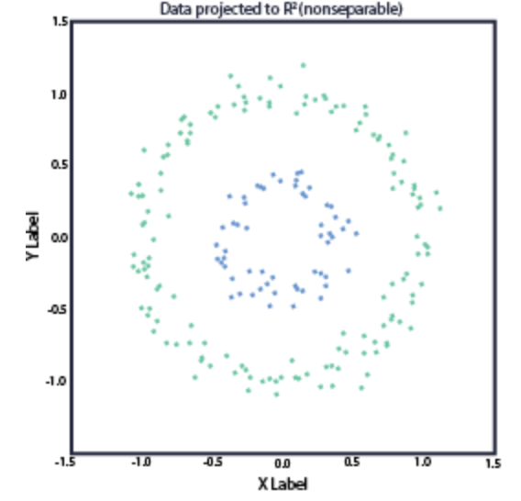
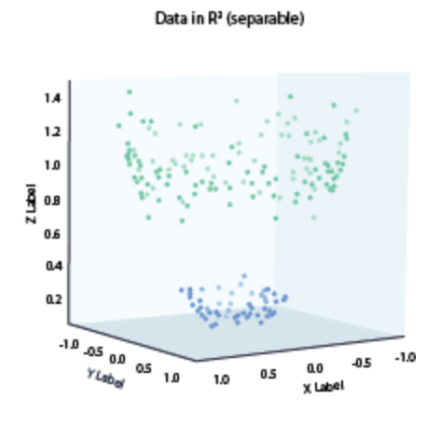


Feature Maps
What if the data is not linearly separable?
$$φ\left(x\right)$$
Project the data onto a higher dimensional feature space using a feature map!
$$φ\left(x\right)=φ\left({\left\{1,x_{1},x_{2}\right\}}^{T}\right)={\left\{1,x_{1},x_{2},x_{1}x_{2}\right\}}^{T}$$

Slide 6




Feature Maps
A feature map $φ\left(x\right)$ projects the $d$-dimensional data onto the higher dimensional ($p, p>d$) feature space:
$$φ:ℝ^{d}→ℝ^{p}$$
$y_{θ}\left(x\right)=2∗step\left(θ^{T}φ\left(x′\right)\right)−1$
$θ_{k}^{(t+1)}=θ_{k}^{(t)}+η\left(y^{(i)}−{θ^{\left(t\right)}}^{T}φ\left({x′}^{\left(i\right)}\right)\right)φ\left({x′}^{\left(i\right)}\right)$
For $p≫d$ this is computationally very inefficient!
For $p=∞$ this can not be evaluated!
$$\left\langle θ^{\left(t\right)},φ\left(x′\right)\right\rangle \sim 𝒪\left(p\right)$$
$$\left\langle θ^{\left(t\right)},φ\left(x′\right)\right\rangle \sim 𝒪\left(p\right)$$

Slide 7

Feature Maps
Polynomial feature map degree $t$ (example $d=2$):
$φ_{t=2}\left({\left\{1,x_{1},x_{2}\right\}}^{T}\right)={\left\{1,\sqrt{2}x_{1},\sqrt{2}x_{2},\sqrt{2}x_{1}x_{2}, {x_{1}}^{2}, {x_{2}}^{2}\right\}}^{T}$ , $p=6$
In general $p\sim 𝒪\left(d^{t}\right)$
Ex.: $d=1000, t=3→p\sim {1000}^{3}={10}^{9}$
A Radial Basis Function feature map has $p=∞$

Slide 8

Kernels and Feature Maps
Let the kernel be $κ_{φ}\left(x,z\right)=$ $\left\langle φ(x),φ(z)\right\rangle$ and express how similar $x$ is to $z$ in the feature space $φ$
then our model is evaluated in feature space, with complexity $𝒪\left(p\right)$
$$x_{φ}=φ(x)$$
$$f_{θ,φ}\left(φ(x) \right)=θ_{0}+θ_{1}x_{φ,1}+⋯+θ_{p}x_{φ,p}=\left\langle θ,φ\left(x\right) \right\rangle$$
and similarly with learning (there are $p+1$ parameters):
$θ_{k}^{(t+1)}=θ_{k}^{(t)}+η∇ L\left(\left\langle θ,φ\left(x\right) \right\rangle ,y^{(i)}\right), k=0⋯p$
See Andrew Ng, CS229 course notes, chapter 5, for details

Slide 9



The kernel trick
There are kernels $κ_{φ}\left(x,z\right)=\left\langle φ\left(x\right),φ\left(z\right)\right\rangle$ which admit an efficient analytical solution and do not require evaluating any $φ\left(∙\right)$
All computations are done in the data original space ($d$ dimensional) whereas the model lives in the feature space ($p$ dimensional)
Polynomial kernel $κ_{t}\left(x,z\right)$(feature map $φ_{t}$)
$$κ_{t}\left(x,z\right)=\left\langle φ_{t}\left(x\right),φ_{t}\left(z\right)\right\rangle ={\left\langle x,z\right\rangle }^{t}$$
$$𝒪\left(d\right)$$
$$𝒪\left(t+d\right)≪𝒪\left(p\right)=𝒪\left(d^{t}\right)$$

Slide 10


The kernel trick – polynomial example
$φ_{t=2}\left({\left\{1,x_{1},x_{2}\right\}}^{T}\right)={\left\{1,\sqrt{2}x_{1},\sqrt{2}x_{2},\sqrt{2}x_{1}x_{2}, {x_{1}}^{2}, {x_{2}}^{2}\right\}}^{T}$
$φ_{t=2}\left({\left\{1,z_{1},z_{2}\right\}}^{T}\right)={\left\{1,\sqrt{2}z_{1}, \sqrt{2}z_{2},\sqrt{2}z_{1}z_{2}, {z_{1}}^{2}, {z_{2}}^{2}\right\}}^{T}$
$κ_{φ}\left(x,z\right)=\left\langle φ\left(x\right),φ\left(z\right)\right\rangle =1+ 2x_{1}z_{1}+ 2x_{2}z_{2}+ 2x_{1}x_{2}z_{1}z_{2}+ {x_{1}}^{2}{z_{1}}^{2}+ {x_{1}}^{2}{z_{2}}^{2}$
Polynomial kernel $κ_{t}\left(x,z\right)=\left\langle φ_{t}\left(x\right),φ_{t}\left(z\right)\right\rangle ={\left\langle x,z\right\rangle }^{t}$
$\left\langle x,z\right\rangle =1+x_{1}z_{1}+x_{1}z_{2}$
${\left\langle x,z\right\rangle }^{2}= {(1+x_{1}z_{1}+x_{1}z_{2})}^{2}=1+ 2x_{1}z_{1}+ 2x_{2}z_{2}+ 2x_{1}x_{2}z_{1}z_{2}+ {x_{1}}^{2}{z_{1}}^{2}+ {x_{1}}^{2}{z_{2}}^{2}$
There are alternative definitions of the polynomial kernel, e.g.,
$$κ_{t}\left(x,z\right)=\sum_{u=0}^{t}{{\left\langle x,z\right\rangle }^{u}}$$

Slide 11

The kernel trick
Radial Basis Function or Gaussian Kernel $κ_{σ}\left(x,z\right)$(feature map $φ_{σ}$)
$κ_{σ}\left(x,z\right)=\left\langle φ_{σ}\left(x\right),φ_{σ}\left(z\right)\right\rangle =e^{−\frac{\left\|x−z\right\|}{2σ^{2}}}$ , $𝒪\left(d\right)$ where $p=∞$
MAIN TAKEAWAY:
The kernel trick allows retaining the advantages of a p-dimensional feature space, while only requiring computations to be done in the d-dimensional data space

Slide 12

Rewriting the linear model
$f_{θ,φ}\left(x\right)=\left\langle θ,φ\left(x\right)\right\rangle =\sum_{i=1}^{M}{\left(β_{i}\left\langle φ\left(x^{(i)}\right),φ\left(x\right)\right\rangle \right)}$,
$x^{(i)}∈𝒟=\left\{\left(x^{(1)},y^{(1)}\right),⋯,\left(x^{(M)},y^{(M)}\right)\right\}$
Let the kernel be $κ\left(x,z\right)=$ $\left\langle φ(x),φ(z)\right\rangle$ and express how similar $x$ is to $z$
Let $K\left(x\right)$ be the vector $\left\{κ\left(x^{(1)},x\right),⋯,κ\left(x^{(M)},x\right)\right\}$
then our model evaluates in feature space $φ$ how similar $x$ is to each $x^{(i)}$ in the training data set and weights it accordingly against the parameter $β_{i}$
$$f_{θ,φ}\left(x\right)=f_{β,φ}\left(x\right)=\left\langle β,K\left(x\right)\right\rangle =\sum_{i=1}^{M}{\left(β_{i}κ\left(x^{(i)},x\right)\right)}$$
See Andrew Ng, CS229 course notes, chapter 5, for details

Slide 13

Rewriting the linear model
$$f_{β}\left(x\right)=\left\langle β,K\left(x\right)\right\rangle =\sum_{i=1}^{M}{\left(β_{i}κ\left(x^{(i)},x\right)\right)}$$
To learn $β$:
$$i=1⋯M, β_{i}^{\left(t+1\right)}←β_{i}^{\left(t\right)}+η\left(y^{(i)}−\sum_{j=1}^{M}{\left(β_{j}^{(t)}κ\left(x^{(i)},x^{(j)}\right)\right)}\right)$$
The kernel $κ\left(x,z\right)=$ $\left\langle φ\left(x\right),φ\left(z\right)\right\rangle$ has to be evaluated $M^{2}$ times,
one for each pair $\left(x^{(i)},x^{(j)}\right)∈𝒟^{2}$
If $κ\left(x,z\right)$admits an efficient analytical solution (kernel trick) then $𝒪\left(M^{2}d\right)$, else $𝒪\left(M^{2}p\right)$

Slide 14

Support Vector Machines (SVM)
Family of kernel based methods for classification
we focus on binary classification, but multi-class (SVC) and regression(SVR) also possible
Supervised method which finds a hyperplane separating the classes
training input ($M$ labelled data points): $𝒟=\left\{\left(x^{1},y^{1}\right),⋯,\left(x^{M},y^{M}\right)\right\}$
each $x^{i}∈ℝ^{N}$, $x^{i}={\left(x_{1}^{i},⋯,x_{N}^{i}\right)}^{T}$ for $N$ features
each $y^{i}∈\left\{−1,1\right\}$ for binary classification
The training stage finds the class separating hyperplane
The classification stage classifies a previously unseen unlabelled data point $u∈ℝ^{N}$ as $y^{u}∈\left\{−1,1\right\}$

Slide 15
Support Vector Machines (SVM)
There are infinite hyperplanes separating the two classes. Which hyperplane to select?
Even though both hyperplanes behave well for the training data set,
they generalize differently for the new green data point

Slide 16
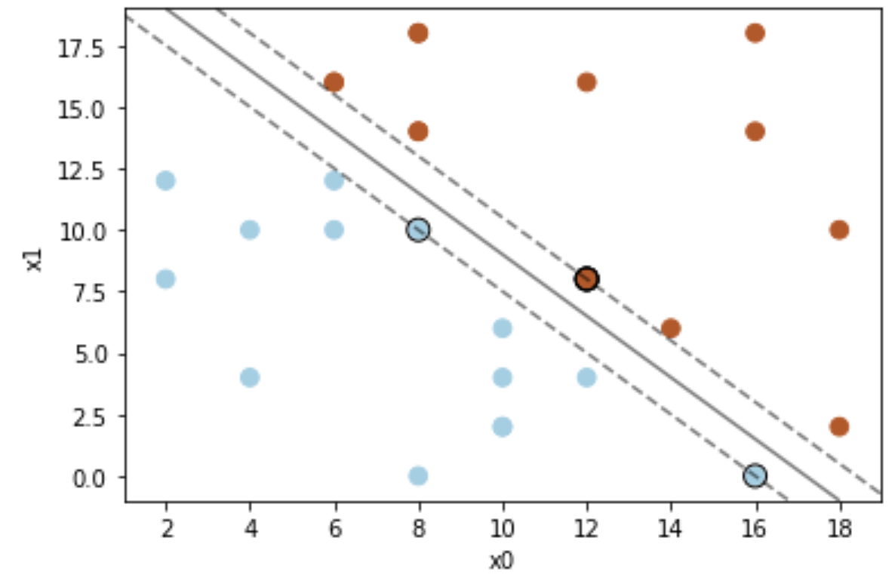




Support Vector Machines (SVM)
Select the hyperplane which maximizes the “margin”, i.e, the distance to the nearest points on each class.
These are the support vectors
The vector $w∈ℝ^{N}$ is perpendicular to the hyperplane
The points in the hyperplane obey
$f_{w,b}\left(x\right)=w^{T}x+b=0$
The training stage optimizes over $w$ and $b$, maximizing the margin $Δ$
$$w$$
$$Δ$$
$$Δ$$

Slide 17



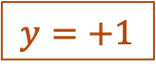
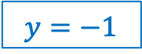



Support Vector Machines (SVM)
$$y=+1$$
$$w$$
$$w^{T}x+b≥+1$$
$$w^{T}x+b=+1$$
$$y\left(w^{T}x+b\right)≥1$$
$$w^{T}x+b≤−1$$
$$y=−1$$
$$w^{T}x+b=−1$$

Slide 18



Support Vector Machines (SVM)
Primal model:
$f_{w,b}\left(x\right)=w^{T}x+b=θ^{T}x′=\left\langle θ,x′\right\rangle$, with $θ^{T}=\left\{b,w^{T}\right\}$
Primal objective function:
$\min_{w,b}\left(\frac{1}{2}{\left\|w\right\|}^{2}\right) s.t. y^{m}\left(w^{T}x^{m}+b\right)≥1$
$𝒪\left(d\right)$ or $𝒪\left(p\right)$ if a feature map is used
$𝒪\left(d\right)$ or $𝒪\left(p\right)$ if a feature map is used
See:
Andrew Ng, CS229 course notes, chapter 5, for details
Qiskit Global Summer School 2021: Lectures 6.1

Slide 19




Support Vector Machines (SVM)
Distance between $x$ and each data point $x^{(i)}∈𝒟$
Dual model:
$f_{α,b}\left(x\right)=\sum_{i=1}^{M}{\left(α_{i}y^{(i)}\left\langle x^{(i)},x\right\rangle \right)}+b$
Dual objective function:
$\max_{α}\left(\sum_{i=1}^{M}{α_{i}}−\frac{1}{2}\sum_{i=1}^{M}{\sum_{j=1}^{M}{α_{i}α_{j}y^{(i)}y^{(j)}\left\langle x^{(i)},x^{(j)}\right\rangle }}\right)$
$α_{i}≠0$ only for the support vectors,
$S=\left\{indexes of the support vectors\right\}$, $\left|S\right|≪M$
Distance between pairs $\left(x^{(i)},x^{(j)}\right)∈𝒟^{2}$
See:
Andrew Ng, CS229 course notes, chapter 5, for details
Qiskit Global Summer School 2021: Lectures 6.1

Slide 20


Support Vector Machines (SVM)
$α_{i}≠0$ only for the support vectors,
$S=\left\{indexes of the support vectors\right\}$, $\left|S\right|≪M$
Dual model: $f_{α,b}\left(x\right)=\sum_{i∈S}{\left(α_{i}y^{(i)}\left\langle x^{(i)},x\right\rangle \right)}+b$
Dual objective function:$\max_{α}\left(\sum_{i∈S}{α_{i}}−\frac{1}{2}\sum_{i∈S}{\sum_{j∈S}{α_{i}α_{j}y^{(i)}y^{(j)}\left\langle x^{(i)},x^{(j)}\right\rangle }}\right)$
Classification: $label\left(x\right)=2∗step\left(\sum_{i∈S}{\left(α_{i}y^{\left(i\right)}\left\langle x^{\left(i\right)},x\right\rangle \right)}+b\right)−1$
See:
Andrew Ng, CS229 course notes, chapter 5, for details
Qiskit Global Summer School 2021: Lectures 6.1

Slide 21


SVM and Kernels
$𝒪\left(d\right)$ - kernel trick
$f_{α,b}\left(x\right)=\sum_{i∈S}{\left(α_{i}y^{(i)}κ\left(x^{(i)},x\right)\right)}+b$
Optimization: $\max_{α}\left(\sum_{i∈S}{α_{i}}−\frac{1}{2}\sum_{(i,j)∈S^{2}}{α_{i}α_{j}y^{(i)}y^{(j)}κ\left(x^{(i)},x\right)}\right)$
Classification: $label\left(x\right)=2∗step\left(\sum_{i∈S}{\left(α_{i}y^{\left(i\right)}κ\left(x^{(i)},x\right)\right)}+b\right)−1$
See:
Andrew Ng, CS229 course notes, chapter 5, for details
Qiskit Global Summer School 2021: Lectures 6.1

Slide 22
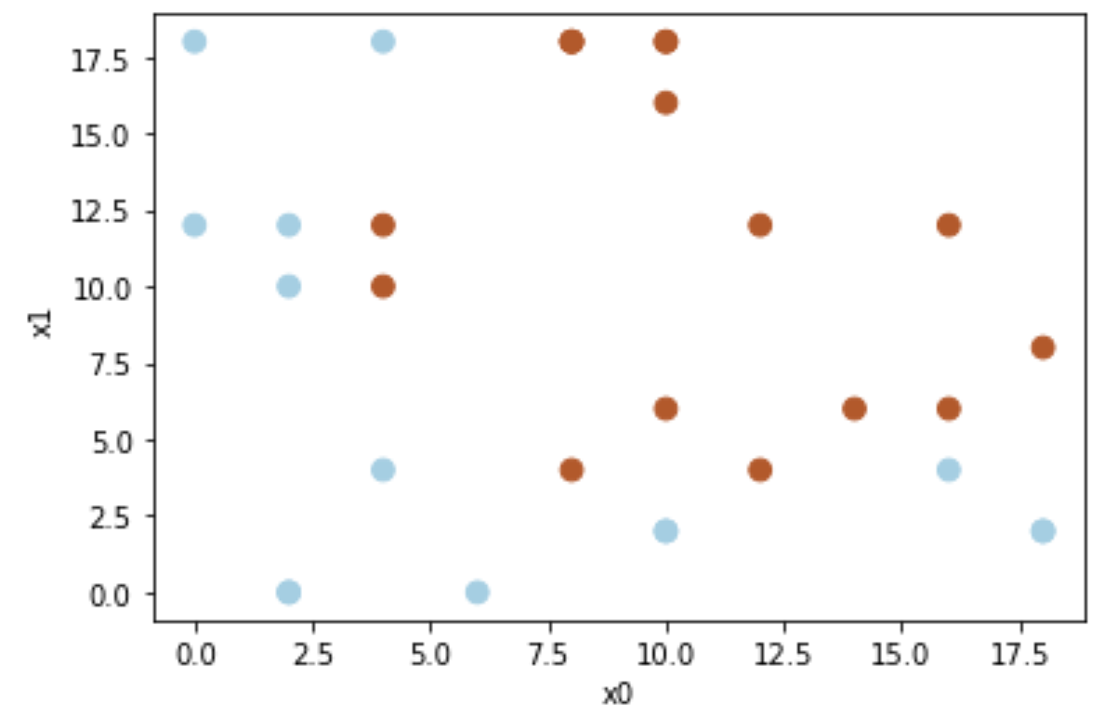
SVM and Feature Maps
Consider the non linearly separable data set

Slide 23


SVM and Feature Maps
Use the following polynomial feature map:
$$φ\left(x\right) :\left(1,x_{0},x_{1}\right)⟶\left(1,\sqrt{2}x_{0},\sqrt{2}x_{1},\sqrt{2}x_{0}x_{1},x_{0}^{2},x_{1}^{2}\right)$$
$$\left\langle φ\left(x\right),φ\left(z\right)\right\rangle =1+2 x_{0}z_{0}+2 x_{1}z_{1}+2x_{0}z_{0}x_{1}z_{1}+x_{0}^{2}z_{0}^{2}+x_{1}^{2}z_{1}^{2}$$
$$\left\langle x,z\right\rangle =1+ x_{0}z_{0}+ x_{1}z_{1}$$
$${\left\langle x,z\right\rangle }^{2}=\left(1+ x_{0}z_{0}+ x_{1}z_{1}\right)\left(1+ x_{0}z_{0}+ x_{1}z_{1}\right)=$$
$$=1+2x_{0}z_{0}+2x_{1}z_{1}+2x_{0}z_{0}x_{1}z_{1}+x_{0}^{2}z_{0}^{2}+x_{1}^{2}z_{1}^{2}$$
$κ\left(x,z\right)=$ ${\left\langle x,z\right\rangle }^{2}$

Slide 24
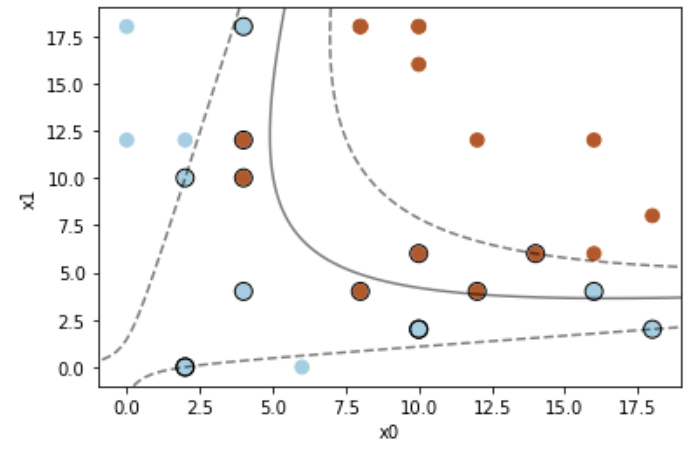

SVM and Feature Maps
$κ\left(x,z\right)=$ ${\left\langle x,z\right\rangle }^{2}$

Slide 25
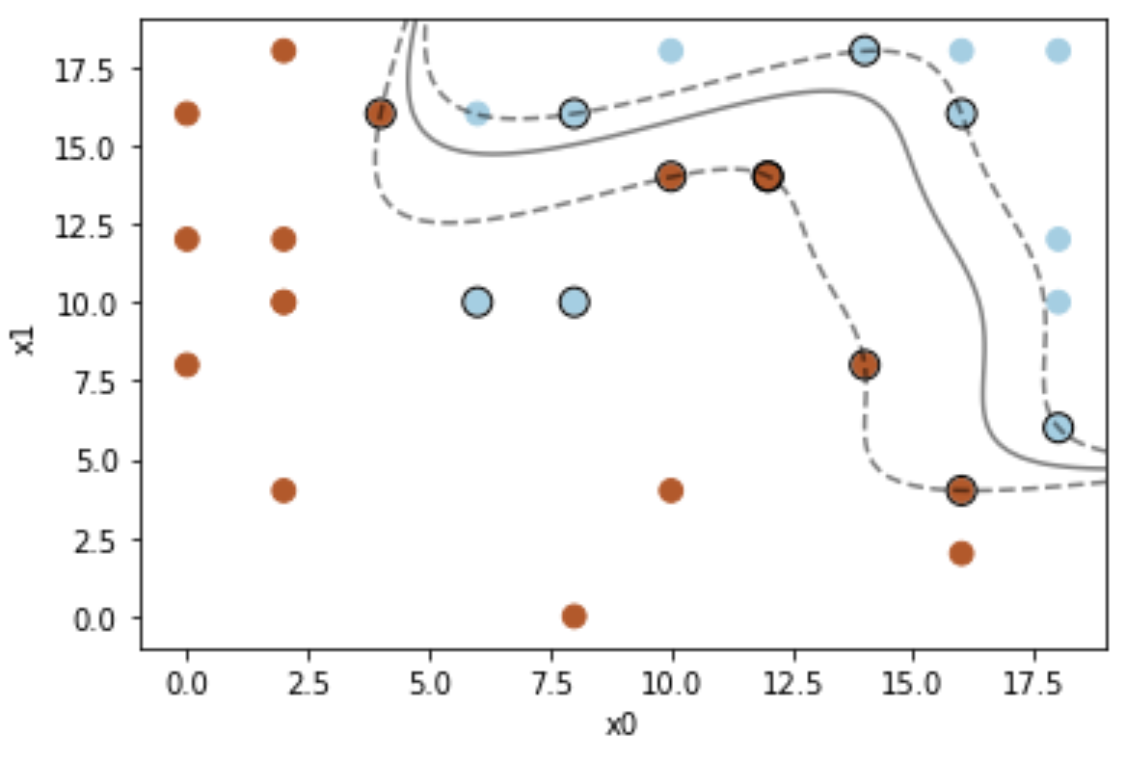
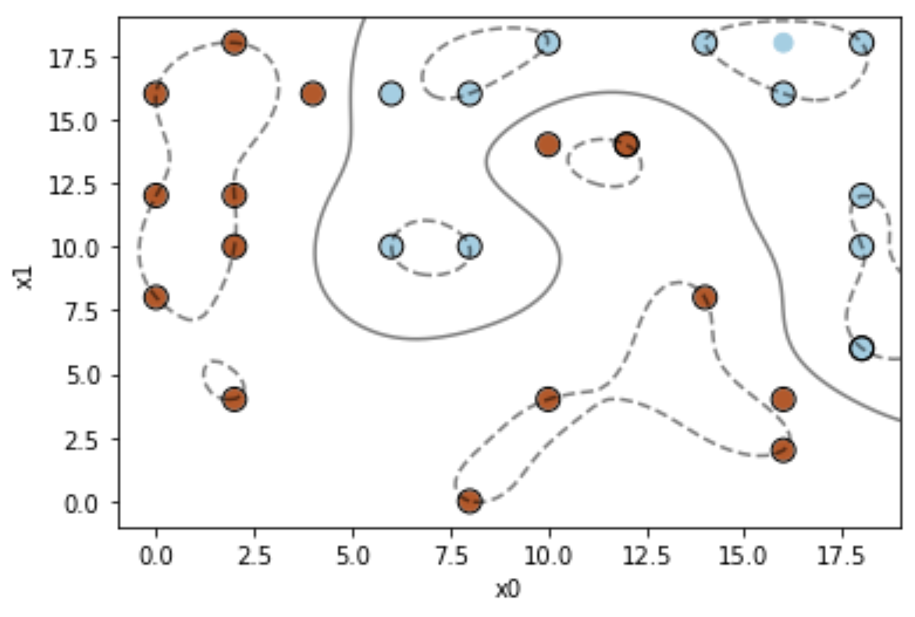
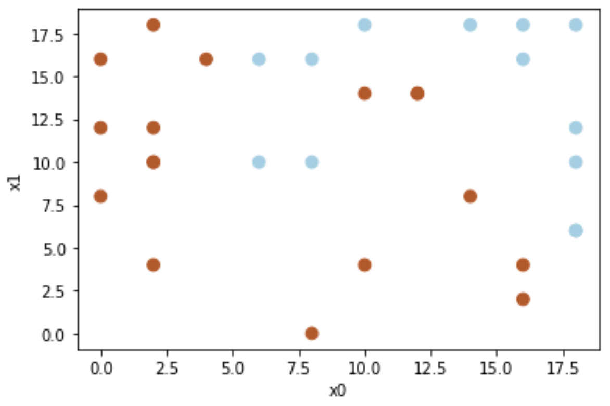
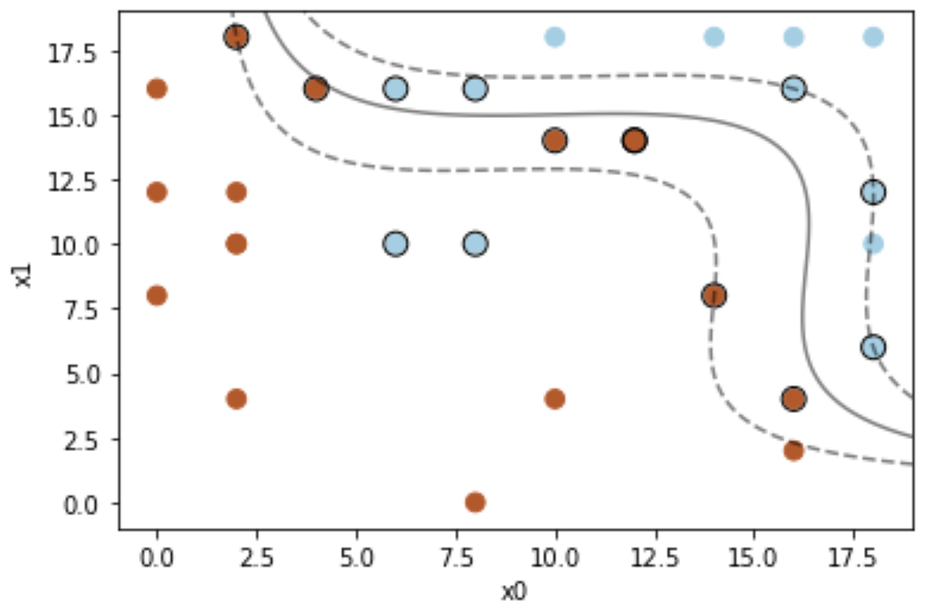



SVM and Feature Maps
Feature spaces with very large dimensionalities (even infinite) can be handled efficienciently
polynomial feature map
$t=4$, $p\sim 𝒪\left(2^{4}\right)=𝒪\left(16\right)$
polynomial feature map
$t=7$ , $p\sim 𝒪\left(2^{7}\right)=𝒪\left(128\right)$
RBF feature map
$$p=∞$$

Slide 26

Clustering
clustering is an unsupervised learning algorithm partitioning $M$ data points $x^{(i)}$ into subsets, or clusters. The algorithm seeks to find the clusters which maximize the similarity between each cluster’s members.

Slide 27



K-means clustering
Given non-labelled data set $𝒟=\left\{x^{1},⋯,x^{M}\right\}$ of $M$ points and the number $K$ of desired clusters, partition $𝒟$ into $K$ subsets, minimizing the distance among cluster members.
randomly select K centroids $C^{k}$ from $𝒟=\left\{x^{1},⋯,x^{M}\right\}$
while not stop
for each $x^{i} ε$ $𝒟$
for each cluster with centroid $C^{k}, k=1⋯K$
${\text{distance}}_{i,k}=\left\|C^{k}−x^{i}\right\|$
assign $x^{i}$ to cluster k with minimum ${\text{distance}}_{i,k}$
for each cluster $k=1⋯K$ compute the new centroid as the mean of all the cluster members
if (new centroids == previous centroids) stop = True

Slide 28
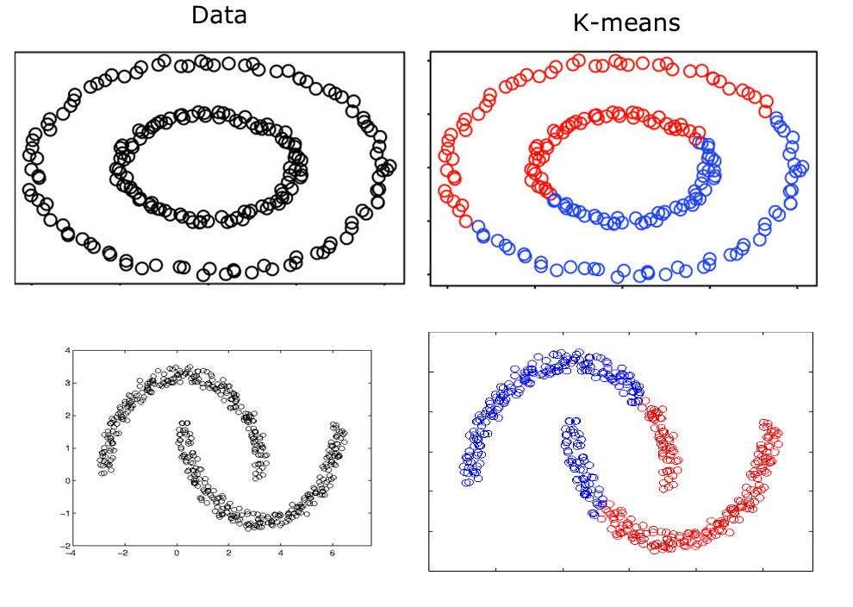
K-means clustering
$κ\left(x,z\right)=\left\|z−x\right\|$, Euclidean distance requires linear separability

Slide 29

Euclidean distance and feature map
${\left\|z−x\right\|}^{2}=\sum_{j=1}^{d}{{\left(z_{j}−x_{j}\right)}^{2}}$ ${\left\|z−x\right\|}^{2}=\left\langle z−x,z−x\right\rangle$ ${\left\|z−x\right\|}^{2}=\left\langle z,z\right\rangle −2\left\langle z,x\right\rangle$+ $\left\langle x,x\right\rangle$
$φ\left(x\right) :\left(1,x_{0},x_{1}\right)⟶\left(1,\sqrt{2}x_{0},\sqrt{2}x_{1},\sqrt{2}x_{0}x_{1},x_{0}^{2},x_{1}^{2}\right)$ $\left\langle φ\left(x\right),φ\left(z\right)\right\rangle = {\left\langle x,z\right\rangle }^{2}$
${\left\|φ\left(z\right)−φ\left(x\right)\right\|}^{2}={\left\langle z,z\right\rangle }^{2}−2{\left\langle z,x\right\rangle }^{2}+{\left\langle x,x\right\rangle }^{2}$

Slide 30
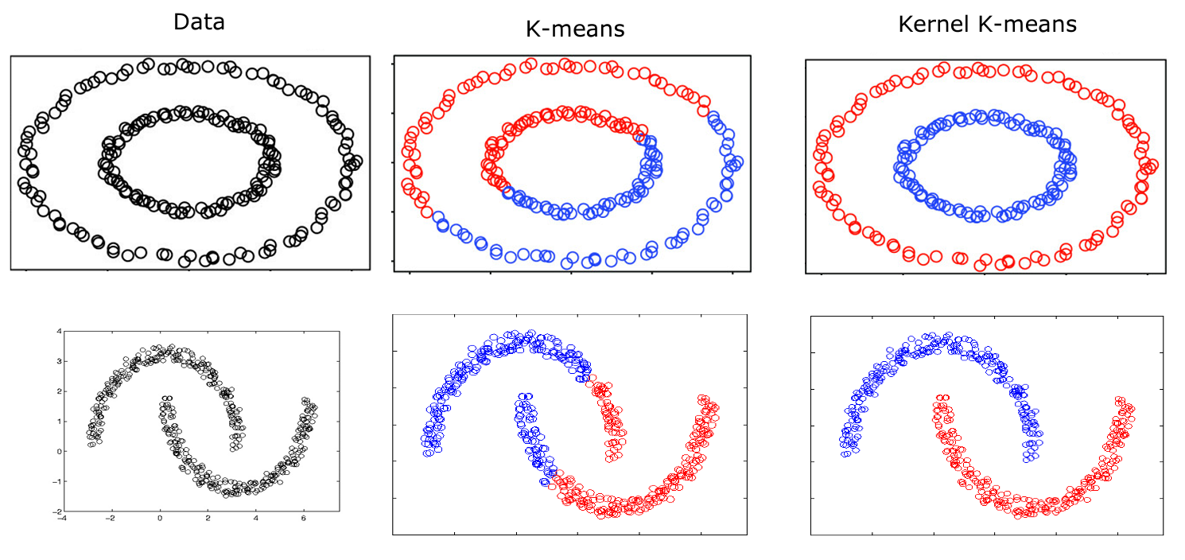
Kernel K-means clustering
$$κ\left(x,z\right)={\left\|φ\left(z\right)−φ\left(x\right)\right\|}^{2}={\left\langle z,z\right\rangle }^{2}−2{\left\langle z,x\right\rangle }^{2}+{\left\langle x,x\right\rangle }^{2}$$
$$φ\left(x\right) :\left(1,x_{0},x_{1}\right)⟶\left(1,\sqrt{2}x_{0},\sqrt{2}x_{1},\sqrt{2}x_{0}x_{1},x_{0}^{2},x_{1}^{2}\right)$$

